Slide 1

Department of Information Technology
Session 2024-25
Major Project Title Selection Seminar on
Learning Management System using LLaMa
Presented By Group No: 26
Ms. Aishwarya Maske (Roll no:102) Mr. Abhijeet Konar (Roll no:132) Mr. Pralendra Behera (Roll no:162) Mr. Pawan Balpande (Roll no:161) Mr. Samyak Labhane (Roll no:165)
Guided By
Ast. Prof. Priti Matre

Slide 2
Contents
Abstract
Introduction
Problem Definition
Aim & Objectives
Literature Review
Patent Search
Research Gap
Hardware Software Requirement
Proposed methodology
Plan of Action
References

Slide 3
Abstract
Innovative solution for "Intelligent Search and Task Optimization," which improves data retrieval and resource management by employing LLaMA, a powerful generative AI model.
Traditional systems frequently experience inefficiencies when dealing with real-time, complicated queries, and computationally intensive operations. This system tackles these issues by leveraging LLaMA, which allows for dynamic, context-aware interactions that assure accurate, relevant search results while streamlining job execution.
The architecture includes a web-based user interface for media searches, intelligent agents that evaluate user queries and recommend next steps, and SearXNG for metadata-driven web searches.

Slide 4
Introduction
In today’s information-rich environment, college students have access to an unprecedented wealth of resources.
Despite the vast array of online materials—from academic journals and video lectures to tutorials and forums—many students struggle to effectively utilize the internet for skill enhancement and personal development.
This paradox of abundance can lead to confusion and overwhelm, making it difficult for individuals to discern which resources are most relevant to their needs.
Additionally, the rapid pace of technological advancements often outstrips students' ability to keep up, resulting in a skills gap that can hinder their academic and professional growth.
Traditional educational frameworks may not adequately prepare students for this dynamic landscape, leaving them unsure of how to navigate the plethora of information available online.

Slide 5
Problem Definition
Innovative solution for "Intelligent Search and Task Optimization," which improves data retrieval and resource management by employing LLaMA, a powerful generative AI model.
Traditional systems frequently experience inefficiencies when dealing with real-time, complicated queries, and computationally intensive operations. This system tackles these issues by leveraging LLaMA, which allows for dynamic, context-aware interactions that assure accurate, relevant search results while streamlining job execution.
The architecture includes a web-based user interface for media searches, intelligent agents that evaluate user queries and recommend next steps, and SearXNG for metadata-driven web searches.

Slide 6
Aim and Objectives
Aim :
The aim is to create and assess a Learning Management System (LMS) that uses the Large Language Model Meta AI (LLaMA) to provide a personalized, adaptable, and interactive learning experience. Integrating generative AI into the LMS framework aims to improve educational outcomes and engagement by creating intelligent content and providing real-time help.
Objectives :
Dynamic Information Retrieval to develop an intelligent querying system using LLaMA for quick access to relevant resources, reducing information overload.
Contextual Understanding to integrate LLMs to tailor information retrieval based on user context and learning goals.
Resource Recommendation System to implement an algorithm to rank educational resources by relevance and credibility.
Interactive Learning Pathways to create personalized learning pathways to guide students through curated content based on skill levels and interests.

Slide 7
Literature survey
Sr. No. | Title of the paper | Author | Year of Publication / Publisher | Major Observation / findings
 | How can Generative | Carlos Delgado | 2024 IEEE | Generative AI can improve
1. | AI Support Education? | Kloos, Carlos Alario-Hoyos, | Global Engineering | education by helping teachers prepare lessons,
 |  | Patricia Callejo- | Education | giving students personalized
 |  | Pinardo | Conference | feedback, and assisting with
 |  |  | (EDUCON). | data analysis.
 | Generative AI in | Sergio Morales, | 2023 IEEE | Generative AI tools can
2. | Model-Driven Software Engineering | Elena Planas, Robert Clariso, | conference on Model Driven | improve learning and teaching in software
 | Education: Friend or | Martin Gogola | Engineering | engineering by automating
 | Foe? |  | Languages and | tasks and creating code.
 |  |  | Systems
 |  |  | Companian
 |  |  | (MODELS-C)

Slide 8
Literature survey
Sr. No. | Title of the paper | Author | Year of Publication / Publisher | Major Observation / findings
 | Generative AI | Stevan | 2023 by IEEE in | Generative AI tools in
3. | Applications and Tools in Engineering | Stankovski, Gordana | 23rd International Symposium | engineering education can shift focus from detecting
 | Education | Ostojic, | INFOTECH-JAHO | cheating to enhancing
 |  | Srdan | RINA(INFOTECH | learning and
 |  | Tegeltija | ) | problem-solving
 | Engineering education | Junaid Quadir | 2023 IEEE global | Generative AI, like
4. | in the era of ChatGPT: Promise and Pitfalls of |  | engineering education | ChatGPT, can improve engineering education with
 | generative AI for |  | conference(EDUC | personalized feedback and
 | education |  | ON). | virtual simulations.

Slide 9
Literature survey
5. | Generative AI in Model-Driven Software Engineering Education: Friend or Foe? | Sergio Morales, Elena Planas, Robert Clariso, Martin Gogola | 2023 IEEE conference on Model Driven Engineering Languages and Systems Companian (MODELS-C) | Generative AI tools can improve learning and teaching in software engineering by automating tasks and creating code.
 | Adoption of | Nitirajsingh | 2019 by IEEE in | AI chatbots can boost
6. | AI-Chatbots to Enhance Student | Sandu, Ergun Gide | 18th International Conference on | learning in Indian higher education by
 | Learning Experience |  | Information | improving
 | in Higher Education in |  | Technology | communication and
 | India |  | Based Higher | teaching. The research
 |  |  | Education and | seeks to pinpoint
 |  |  | Training(ITHET) | factors for effective
 |  |  |  | chatbot adoption.

Slide 10
Published Research Paper
Grenze ID: 01.GIJET.11.1.258
Title: Learning Management System Using LLama
Conference Name: Hinweis Third International Conference on Advanced Research in Engineering and Technology, ARET-2025
Abstract: This research presents a Learning Management System (LMS) that integrates LLaMa and SearXNG. LLaMa is an advanced AI language model, and SearXNG is a privacyfocused meta-search engine. Integrated this both for a enhance educational experiences. LLaMa generates precise and contextually relevant response to the user prompts while SearXNG retrieves relevant links and images for further exploration. They both are running on premises hence the security and privacy are ensured for this educational application. This system aims to improve accessibility, engagement and efficiency in modern education.

Slide 11
Research Gap
Issues with the Existing Systems:
Current systems do not intelligently aggregate learning resources across multiple platforms so that learners waste time in searching for relevant materials.
A lot of tools provide generic learning experiences and do not cater to the specific needs or preferences of each user.
Many of the current models do not provide information based on the user's past queries and other factors, even though it is a highly related question.
Traditional platforms have all information provided in a disjointed manner making such already disparate topics worse.
Proposed Solution:
To create an application which searches over the internet using the SearXNG for the images and the refrence links.
Use the LLaMa to generate the content related to the given query and show the search result and the generated content together.

Slide 12
Proposed Methodology
System Architecture:
User Interface (UI):
Built with Next.js for responsiveness and ease of use across devices. Interactive space for user queries.
Agents Module:
LLM Decision: Decides if the LLaMA model or SearXNG is required for a query. Query Understanding: Analyzes user intent before generating results.
Search Integration:
SearXNG: Aggregates diverse, unbiased search results from multiple engines.
Result Aggregation:
Combines outputs from LLaMA and SearXNG for contextual, actionable responses.
Containerization:
Deployed via Docker for scalability and portability across environments.

Slide 13
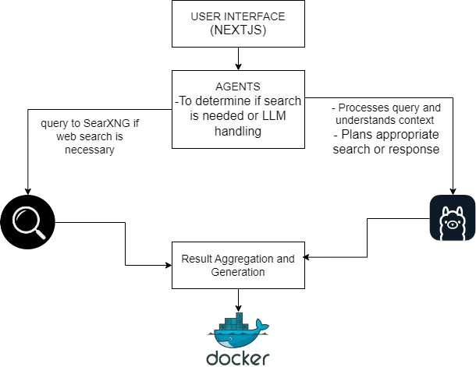
Proposed Methodology

Slide 14

Experimental results/Output/Snapshots

Slide 15

Experimental results/Output/Snapshots

Slide 16
Plan Of Action
Activity (2024-25) | January | February | March | April | May | June
Exercise Expansion and Threshold Definition | ✔ | ✔
Live Feed Integration |  | ✔
Enhanced Feedback System |  |  | ✔
User Personalization and SaaS Features |  |  |  | ✔
System Optimization and Scalability |  |  |  |  | ✔
Testing, Validation, and Deployment |  |  |  |  | ✔
Thesis and Paper Publication |  |  |  |  |  | ✔

Slide 17
Roles and Responsibility
Team member Details | Roles and Responsibility
Aishwarya Maske(102) | Research related to youtube API and Literature survey
Abhijeet Konar (132) | Frontend development
Pawan Balpande(160) | Backend development
Pralendra Behera(161) | Front-end + Backend development
Samyak Labhane(165) | UI + Refactoring of website

Slide 18

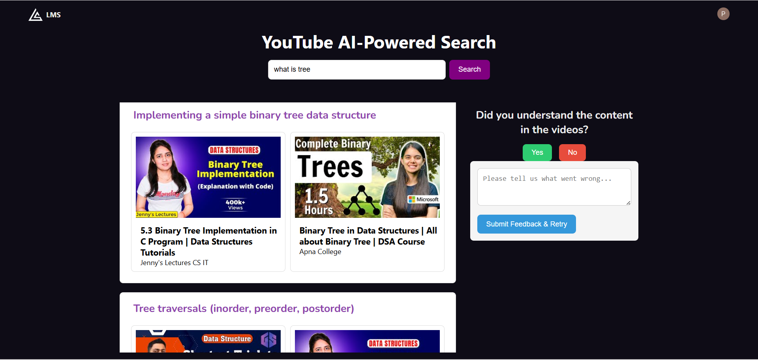
Work on Feedback
We have got the feedback from the panel to work upon the feedback based mechanism before moving to the further modules. This feature is implemented so that we can get the idea about the working about our model and the recommendation. The user experience about the model will be clear to the model which can be used to further enhance our learning management system.

Slide 19
Conclusion and Future scope
Conclusion :
The advancements achieved in Phase 2 upgraded both the functionality and usability of our learning management system. Our improved user interface alongside AI-generated topic structures generates a personalized learning atmosphere with an easier to use design. Users can easily move through topics while their knowledge accumulation advances according to structured difficulty levels. The system developments move us toward achieving our goal of creating an intelligent adaptable learning platform which serves to simplify educational content acquisition.
Future Scope :
Our future development will incorporate sophisticated customization aspects into the system which will enable user-relevant learning recommendations together with customizable difficulty levels. A system for automatic video resource structure and layout will be introduced through a seamless playlist creation process. The development plan involves several improvements including a pursuit efficiency optimization project and progress recording functionality together with platform interaction optimization. The upcoming upgrades will build a learning environment that provides dynamic and efficient engagement to users.

Slide 20

How it is useful for Society
Personalized Learning Experience: By adapting information to individual user requirements and
preferences, the system increases engagement and learning results, allowing students to focus on what is most important to them.
Effective Resource Utilization: Automated curation of instructional materials saves time for both students and educators by decreasing the effort required to identify, organize, and access relevant content.
Enhanced Comprehension: The combination of multimedia materials and contextual insights contributes to deeper knowledge, making complicated concepts more accessible and understandable.
Adaptive Learning Paths: The system's capacity to change course difficulty and deliver real-time feedback creates a more responsive learning environment, allowing students to develop at their own speed while also reinforcing information retention.
Comprehensive Learning Framework: By integrating diverse media types, such as videos, articles, and interactive tools, the system offers a holistic educational experience that caters to various learning styles.
Learning Management System using LLM-(Group-No 26)

Slide 21
References
Zhaoxing Li, Lei Shi, Jindi Wang, Alexandra L.Cristea, Yunzjun Zhou “Sim-GAIL: A generative adversarial imitation learning approach of student modelling for intelligent tutoring system” Springer.
Carlos Delgado Kloos, Carlos Alario-Hoyos, Patricia Callejo-Pinardo, “How can Generative AI Support Education?”, IEEE Global Engineering Education Conference (EDUCON), 2024.
Norita Ahmed, San Murugesan, Nir Kshetri, “Generative artificial intelligence and the education sector”, IEEE, 2023.
Junaid Quadir, “Engineering education in the era of ChatGPT: Promise and Pitfalls of generative AI for education ”, IEEE global engineering education conference(EDUCON), 2023.
San Murugesan, Aswani Kumar Cherukuri, “The rise of generative artificial intelligence and its impact on education : the promises and perils”, IEEE, 2023.
Stevan Stankovski, Gordana Ostojic, Srdan Tegeltija, “Generative AI Applications and Tools in Engineering Education”, IEEE in 23rd International Symposium INFOTECHJAHORINA(INFOTECH), 2023.
Sergio Morales, Elena Planas, Robert Clariso, Martin Gogola, “Generative AI in Model-Driven Software Engineering Education: Friend or Foe?”, IEEE conference on Model Driven Engineering Languages and Systems Companian (MODELS-C), 2023.
Learning Management System using LLM-(Group-No 26) 20

Slide 22
Thank You…….
AI Fitness Assistant For Gym-(Group-No 3)
21

